Slide 1
Lecture 2: Types and Structs
Stanford CS106L, Autumn 2024

Slide 2
Last Time
Introductions!
Why you should take 106L?
Course Logistics

Slide 3
cs106l.stanford.edu

Slide 4
What’s one thing you remember from last lecture?
Pair up and discuss!

Slide 5
Today’s Agenda
What is C++?
Structs bundle data together
Code demo
Improving our code

Slide 6
We’ll cover a LOT of material in this class
Please ask questions!!!

Slide 8
What is C++?

Slide 9
Structure of a C++ Program
// Include other libraries, similar to Python's "import"
#include <iostream>
#include <utility>
#include <cmath>
// Main logic of your program goes here
int main() {
std::cout << "Hello World" << std::endl;
std::cout << "Welcome to " << std::endl;
for (char ch : "CS106L")
{
std::cout << ch << std::endl;
}
}
Hello World
Welcome to
C
S
1
0
6
L

Slide 10
Python
C++
print("Hello World")
print("Welcome to ")
for ch in "CS106L":
print(ch)
std::cout << "Hello World" << std::endl;
std::cout << "Welcome to " << std::endl;
for (char ch : "CS106L")
{
std::cout << ch << std::endl;
}

Slide 11
Okay… but what is C++?

Slide 12
Q1: How do we run code?

Slide 13
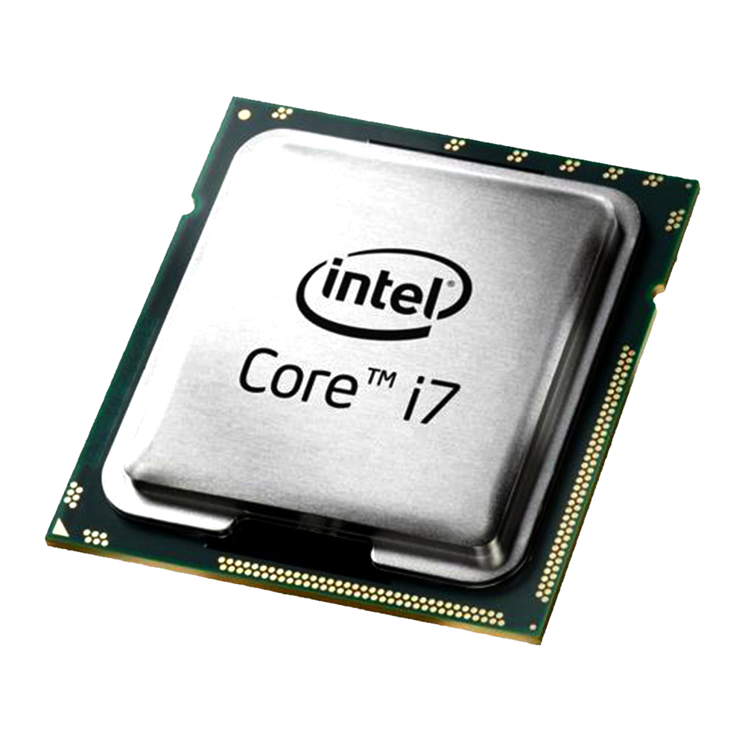
How do we run code?
Source Code
Machine Code
CPU
print("Hello World")
print("Welcome to ")
for ch in "CS106L":
print(ch)
10110101
01011010
10011101
10110001
Translation

Slide 14
Taking a closer look…
Source Code
Machine Code
print("Hello World")
print("Welcome to ")
for ch in "CS106L":
print(ch)
10110101
01011010
10011101
10110001
Translation

Slide 15
Interpreted Languages
Source Code
Machine Code
print("Hello World")
print("Welcome to ")
for ch in "CS106L":
print(ch)
Interpreter
10110101
01011010
10011101
10110001
$ python3 main.py # python3 is the interpreter

Slide 16
Compiled Languages
Source Code
Machine Code
std::cout << "Hello World" << std::endl;
std::cout << "Welcome to " << std::endl;
for (char ch : "CS106L")
{
std::cout << ch << std::endl;
}
Compiler
10110101
01011010
10011101
10110001
$ g++ main.cpp –o main # g++ is the compiler, outputs binary to main
$ ./main # This actually runs our program

Slide 17
Why compile over interpret?
It allows us to generate more efficient machine code!
Interpreters only see one small part of code at a time
Compilers see everything
However, compilation takes time!

Slide 18
C++ is a compiled language

Slide 20
Compile time vs. runtime
std::cout << "Hello World" << std::endl;
std::cout << "Welcome to " << std::endl;
for (char ch : "CS106L")
{
std::cout << ch << std::endl;
}
10110101
01011010
10011101
10110001
Compile Time
Runtime

Slide 21
Aside: “compiled language” is a misleading term

Slide 22
Q1: How do we run code? Q2: How do we verify code?

Slide 23
Python
C++
print("Running...")
hello = "Hello ";
world = "World!";
print(hello * world)
int main() {
std::cout << "Running..." << std::endl;
std::string hello = "Hello ";
std::string world = "World!";
std::cout << hello * world << std::endl;
return 0;
}
$ python3 program.py
Running...
TypeError: can't multiply sequence by
non-int of type 'str'
$ g++ main.cpp
error: no match for 'operator*' (operand types are 'std::string’ and ‘std::string’)

Slide 24
C++ compilers can be noisy… why?
rtmap.cpp: In function `int main()':
rtmap.cpp:19: invalid conversion from `int' to `
std::_Rb_tree_node<std::pair<const int, double> >*'
rtmap.cpp:19: initializing argument 1 of `std::_Rb_tree_iterator<_Val, _Ref,
_Ptr>::_Rb_tree_iterator(std::_Rb_tree_node<_Val>*) [with _Val =
std::pair<const int, double>, _Ref = std::pair<const int, double>&, _Ptr =
std::pair<const int, double>*]'
rtmap.cpp:20: invalid conversion from `int' to `
std::_Rb_tree_node<std::pair<const int, double> >*'
rtmap.cpp:20: initializing argument 1 of `std::_Rb_tree_iterator<_Val, _Ref,
_Ptr>::_Rb_tree_iterator(std::_Rb_tree_node<_Val>*) [with _Val =
std::pair<const int, double>, _Ref = std::pair<const int, double>&, _Ptr =
std::pair<const int, double>*]'
[Source]

Slide 25
Types
A type refers to the “category” of a variable
C++ comes with built-in types
int 106
double 71.4
string “Welcome to CS106L!”
bool true false
size_t 12 // Non-negative

Slide 26
C++ is a statically typed language

Slide 27
Static Typing
Every variable must declare a type
Once declared, the type cannot change
Python (Dynamic Typing)
C++ (Static Typing)
a = 3
b = "test"
def foo(c):
d = 106
d = "hello world!"
int a = 3;
string b = "test";
void foo(string c)
{
int d = 106;
d = "hello world!"; ❌
}

Slide 28
Why static typing?
More efficient
Easier to understand and reason about
Better error checking

Slide 29
Better error checking
def add_3(x):
return x + 3
add_3("CS106L") # Oops, that's a string. Runtime error!
int add_3(int x) {
return x + 3;
}
add_3("CS106L"); // Can't pass a string when int expected. Compile time error!

Slide 31
Your turn
(int) x casts x to an int by dropping decimals
E.g. (int) 5.3 = 5
______ a = “test”;
______ b = 3.2 * 5 - 1;
______ c = 5 / 2;
______ d(int foo) { return foo / 2; }
______ e(double foo) { return foo / 2; }
______ f(double foo) { return (int)(foo + 0.5); }
______ g(double c) { std::cout << c << std::endl; }
string a = “test”;
double b = 3.2 * 5 - 1;
int c = 5 / 2; // What does this equal?
int d(int foo) { return foo / 2; }
double e(double foo) { return foo / 2; }
int f(double foo) { return (int)(foo + 0.5); } // What's this?
void g(double c) { std::cout << c << std::endl; }

Slide 32
Aside: Function Overloading
Defining two functions with the same name but different signatures
double func(int x) { // (1)
return (double) x + 3; // typecast: int → double
}
double func(double x) { // (2)
return x * 3;
}
func(2); // uses version ___, returns ______
func(2.0); // uses version ___, returns ______
(1) 5.0
(2) 6.0

Slide 33
C++ is a compiled, statically typed language

Slide 35
Structs

Slide 36
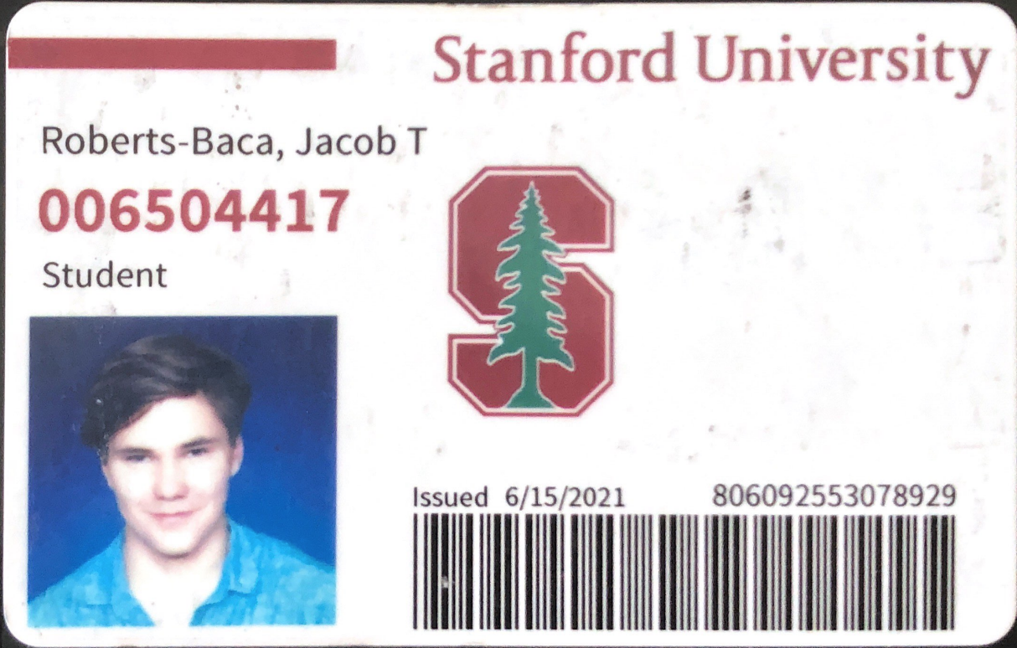
Keeping track of students
Every student ID has a few properties
A name (string)
A SUNet (string)
An ID # (int)

Slide 37
A fundamental problem
_____ issueNewID() {
// How can we return all three things?
// What should our return type be?
// Python:
// return "Jacob Roberts-Baca", "jtrb", 6504417
}
How do we return more than one value?

Slide 38
Introducing… structs!

Slide 39
Structs bundle data together
struct StanfordID {
string name; // These are called fields
string sunet; // Each has a name and type
int idNumber;
};
StanfordID id; // Initialize struct
id.name = "Jacob Roberts-Baca"; // Access field with ‘.’
id.sunet = "jtrb";
id.idNumber = 6504417;

Slide 40
Returning multiple values
StanfordID issueNewID() {
StanfordID id;
id.name = "Jacob Roberts-Baca";
id.sunet = "jtrb";
id.idNumber = 6504417;
return id;
}

Slide 41
List Initialization
We’ll learn more about this next time!
StanfordID id;
id.name = "Jacob Roberts-Baca";
id.sunet = "jtrb";
id.idNumber = 6504417;
// Order depends on field order in struct. ‘=‘ is optional
StanfordID jrb = { "Jacob Roberts-Baca", "jtrb", 6504417 };
StanfordID fi { ”Fabio Ibanez", ”fibanez", 6504418 };

Slide 42
Using list initialization
StanfordID issueNewID() {
StanfordID id = { "Jacob Roberts-Baca", "jtrb", 6504417 };
return id;
}
StanfordID issueNewID() {
return { "Jacob Roberts-Baca", "jtrb", 6504417 };
}

Slide 43
A struct bundles named variables into a new type

Slide 45
Many Possible Structs
struct Name {
string first;
string last;
};
Name jrb = { "Jacob", "R.B." };
struct Order {
string item;
int quantity;
};
Order dozen = { "Eggs", 12 };
Notice anything?
struct Point {
double x;
double y;
};
Point origin { 0.0, 0.0 };
struct Circle {
Point center;
double radius;
};
Circle circle { {0, 0} , 1.0 };

Slide 46
We can use std::pair!

Slide 47
std::pair
struct Order {
std::string item;
int quantity;
};
Order dozen = { "Eggs", 12 };
std::pair<std::string, int> dozen { "Eggs", 12 };
std::string item = dozen.first; // "Eggs"
int quantity = dozen.second; // 12

Slide 48
std::pair is a template
(We’ll learn more about this later)
template <typename T1, typename T2>
struct pair {
T1 first;
T2 second;
};
std::pair<std::string, int>

Slide 49
std::pair is a template
(We’ll learn more about this later)
struct pair {
std::string first;
int second;
};

Slide 50
There’s something we need to discuss…

Slide 51
What is an std !!? 🦠😷
What is std !!?

Slide 52
std ― The C++ Standard Library
Built-in types, functions, and more provided by C++
You need to #include the relevant file
#include <string> → std::string
#include <utility> → std::pair
#include <iostream> → std::cout, std::endl
We prefix standard library names with std::
If we write using namespace std; we don’t have to, but this is considered bad style as it can introduce ambiguity
(What would happen if we defined our own string?)

Slide 53
std ― The C++ Standard Library
See the official standard at cppreference.com!
Avoid cplusplus.com…
It is outdated and filled with ads 😭

Slide 54
To use std::pair, you must #include it
std::pair is defined in a header file called utility
#include <utility>
// Now we can use `std::pair` in our code.
std::pair<double, double> point { 1.0, 2.0 };

Slide 55
What does #include do?
utility
namespace std {
template
<typename T1, typename T2>
struct pair {
T1 first;
T2 second;
};
// Other utility code... }
#include <utility>
std::pair<double, double> p { 1.0, 2.0 };

Slide 56
What does #include do?
namespace std {
template <typename T1, typename T2>
struct pair {
T1 first;
T2 second;
};
// Other utility code... }
std::pair<double, double> p { 1.0, 2.0 };

Slide 58
Code Demo

Slide 59
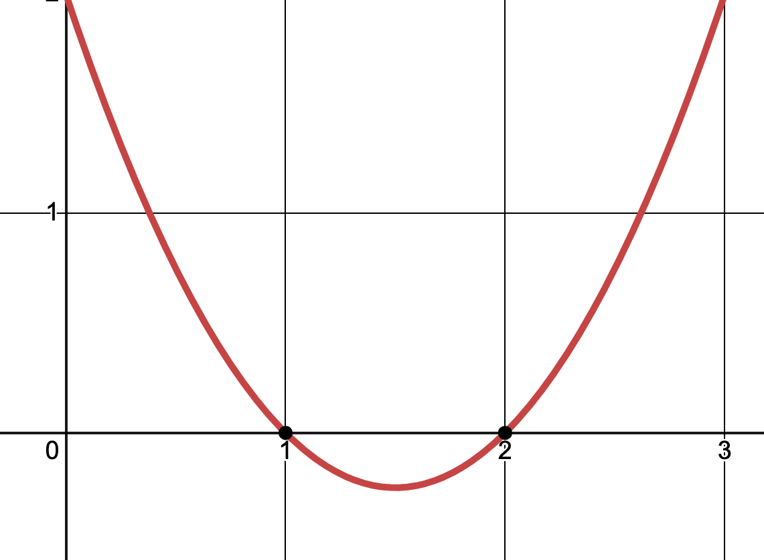
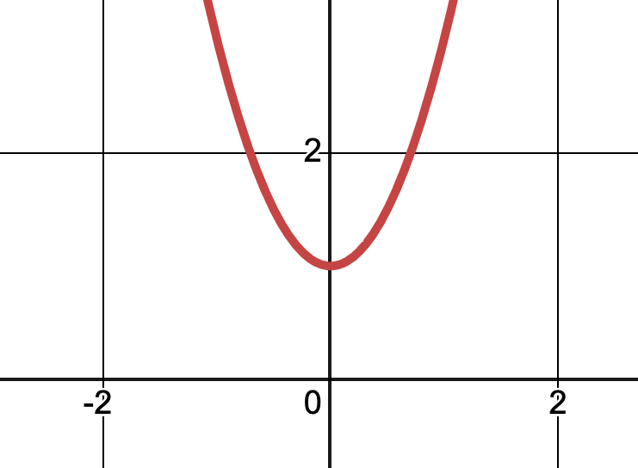
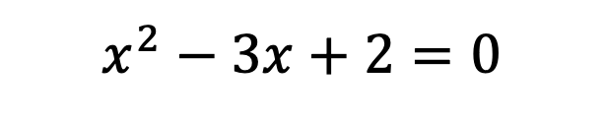
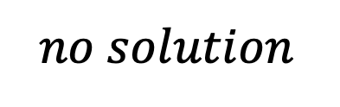
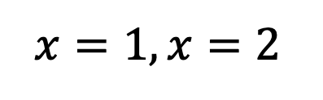
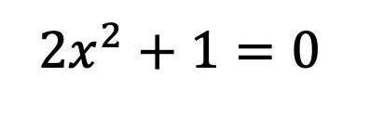
Solving a Quadratic Equation
$$x^{2}−3x+2=0$$
$${2x}^{2}+1=0$$
$$x=1, x=2$$
$$no solution$$

Slide 60

Solving a Quadratic Equation
If we have ${ax}^{2}+bx+c=0$
Solutions are $x=\frac{−b±\sqrt{b^{2}−4ac}}{2a}$
If $b^{2}−4ac$ is negative, there are no solutions

Slide 61
std::pair<bool, std::pair<double, double>> solveQuadratic(double a, double b, double c);
What are the solutions (if any)?
Our return value :D
Is there a solution?
Our coefficients. Yay!

Slide 62
std::pair<bool, std::pair<double, double>>
{ true, { 1.0, 2.0 }}
{ false, doesnt_matter }

Slide 63
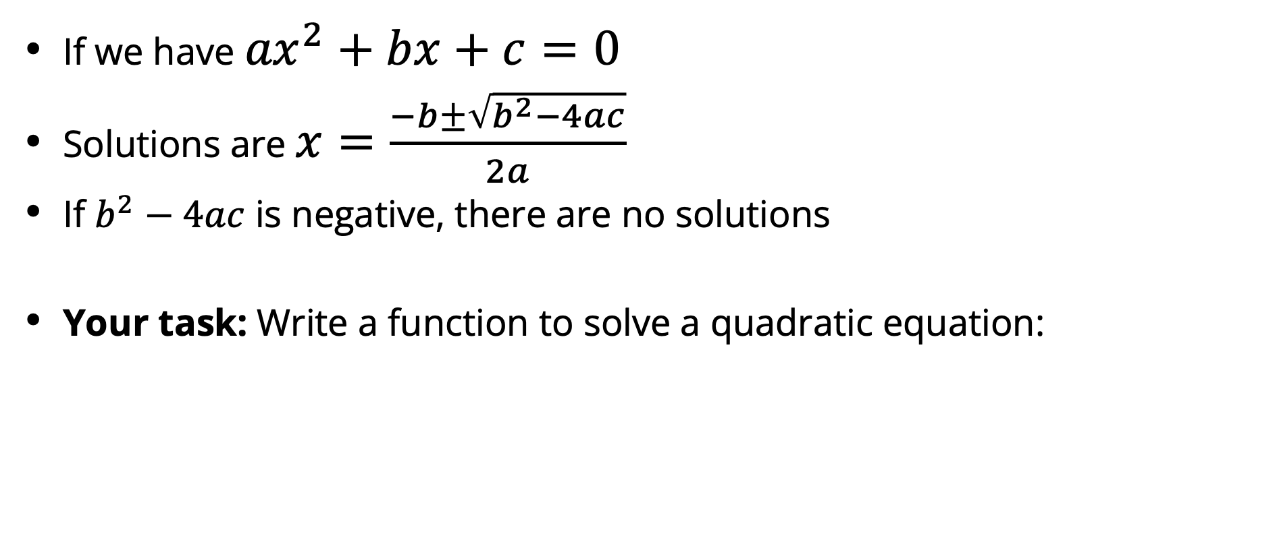
Solving a Quadratic Equation
If we have ${ax}^{2}+bx+c=0$
Solutions are $x=\frac{−b±\sqrt{b^{2}−4ac}}{2a}$
If $b^{2}−4ac$ is negative, there are no solutions
Your task: Write a function to solve a quadratic equation:
std::pair<bool, std::pair<double, double>> solveQuadratic(double a, double b, double c);
📝 The sqrt function from the <cmath> header can calculate the square root

Slide 64
106l.vercel.app/quadratic

Slide 65
Improving Our Code

Slide 66
The using keyword

Slide 67
The using keyword
Typing out long type names gets tiring
We can create type aliases with the using keyword
std::pair<bool, std::pair<double, double>> solveQuadratic(double a, double b, double c);
using Zeros = std::pair<double, double>;
using Solution = std::pair<bool, Zeros>;

Slide 68
using is kind of like a variable for types!

Slide 69
The auto keyword

Slide 70
The auto keyword
The auto keyword tells the compiler to infer the type
std::pair<bool, std::pair<double, double>> result = solveQuadratic(a, b, c);
auto result = solveQuadratic(a, b, c);
// This is exactly the same as the above!
// result still has type std::pair<bool, std::pair<double, double>>
// We just told the compiler to figure this out for us!

Slide 71
auto is still statically typed!
auto i = 1; // int inferred
i = "hello!"; // ❌ Doesn't compile

Slide 72
Which one is clearer?
std::pair<bool, std::pair<double, double>> result = ...;
auto result = ...;

Slide 73
Which one is clearer?
auto i = 1;
int i = 1;

Slide 75
Recap

Slide 76
Recap
C++ is a compiled, statically typed language
Structs bundle data together into a single object
std::pair is a general purpose struct with two fields
#include from the C++ Standard Library to use built-in types
And use the std:: prefix too!
Quality of life features to improve your code
using creates type aliases
auto infers the type of a variable

